Slide 1

Internal Combustion Engine

Slide 2
Teaching Objective & Evaluation Way
- Teaching Objective
Knowledge of ICE and It’s Applications
Characterization of Ignition, it’s control way
Evaluation of Engine performance and Idea for engine design
- Evaluation way
Assessment | Attendance | Mid term exam | Final exam | Homework | report
% | 10 | 35 | 35 | 10 | 10
Homework is SAE Paper Review until mid term exam.
Report is Review of Seminars until Final exam.

Slide 3
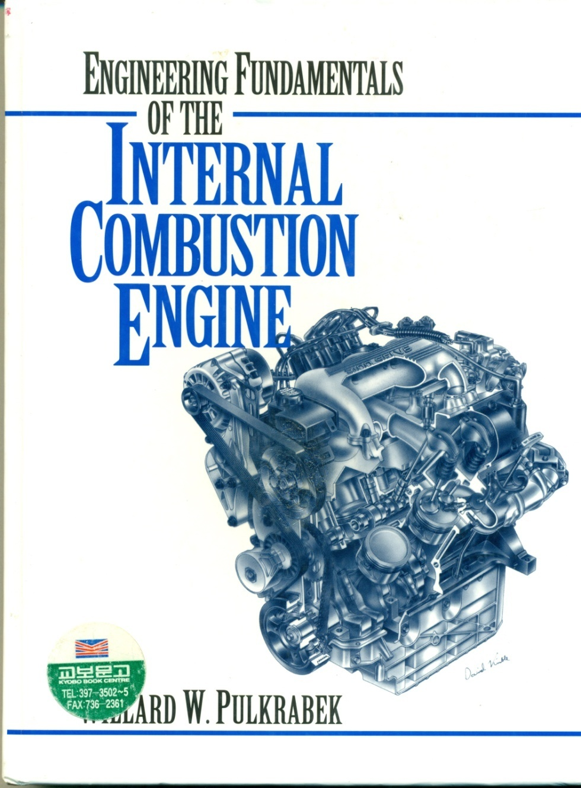
Text Book
Engineering Fundamentals of the internal
combustion engine,
Willard W.Pulkrabek,
Pearson Prentice Hall, 2004

Slide 4
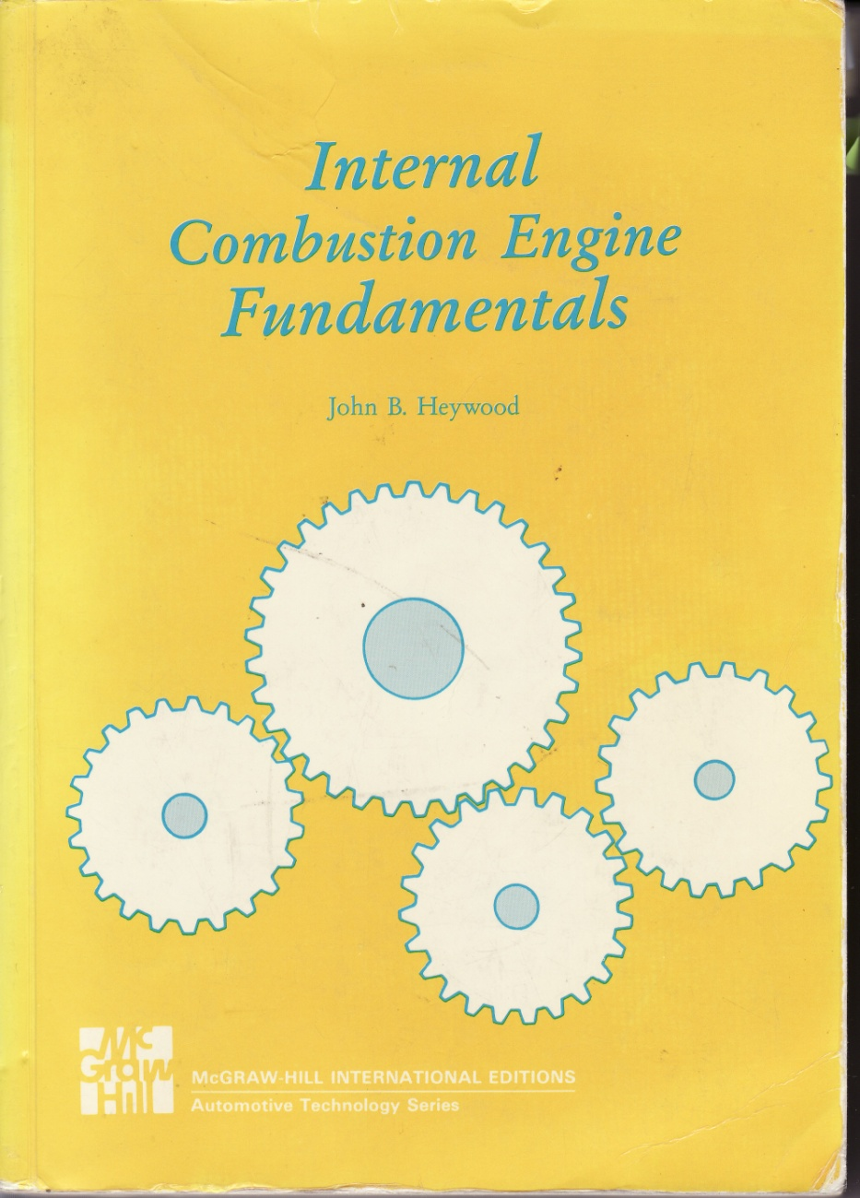
Reference
Internal Combustion Engine Fundamentals,
John Heywood,
McGraw-Hill Science Engineering

Slide 5
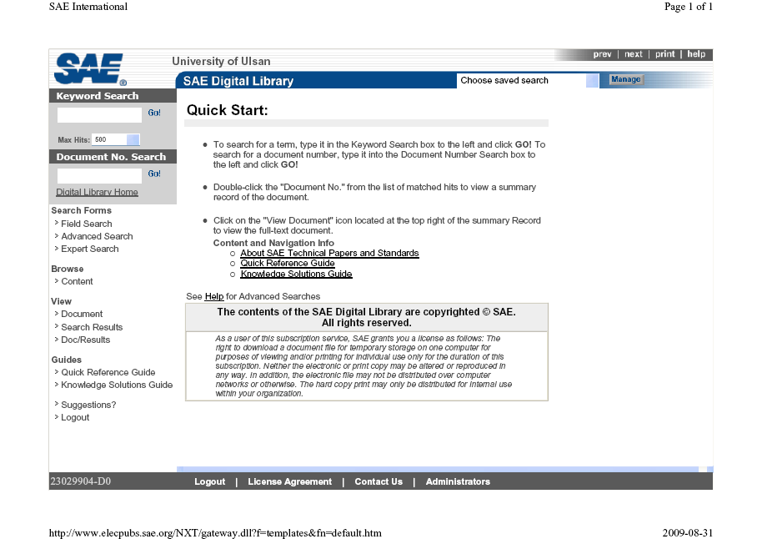
Reference
SAE Paper : www.elecpubs.sae.org
http://library.ulsan.ac.kr 접속가능

Slide 6
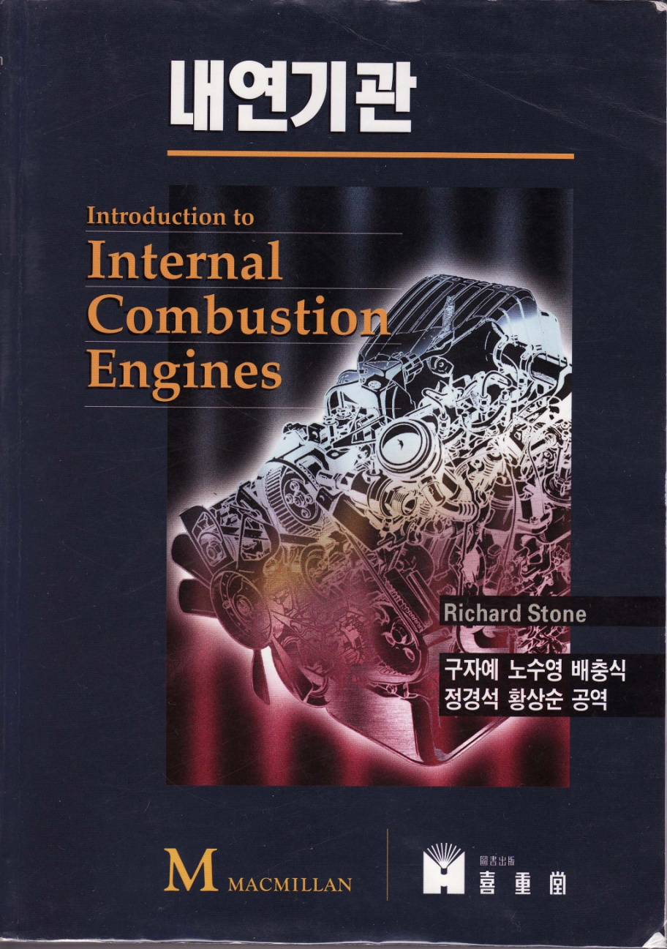
Reference
내연기관,
구자예 외 4인 공역, 희중당 발행 (원본 : Interduction to Internal Combustion Engines, Richard Stone 저, Macmillan 출판사)

Slide 7
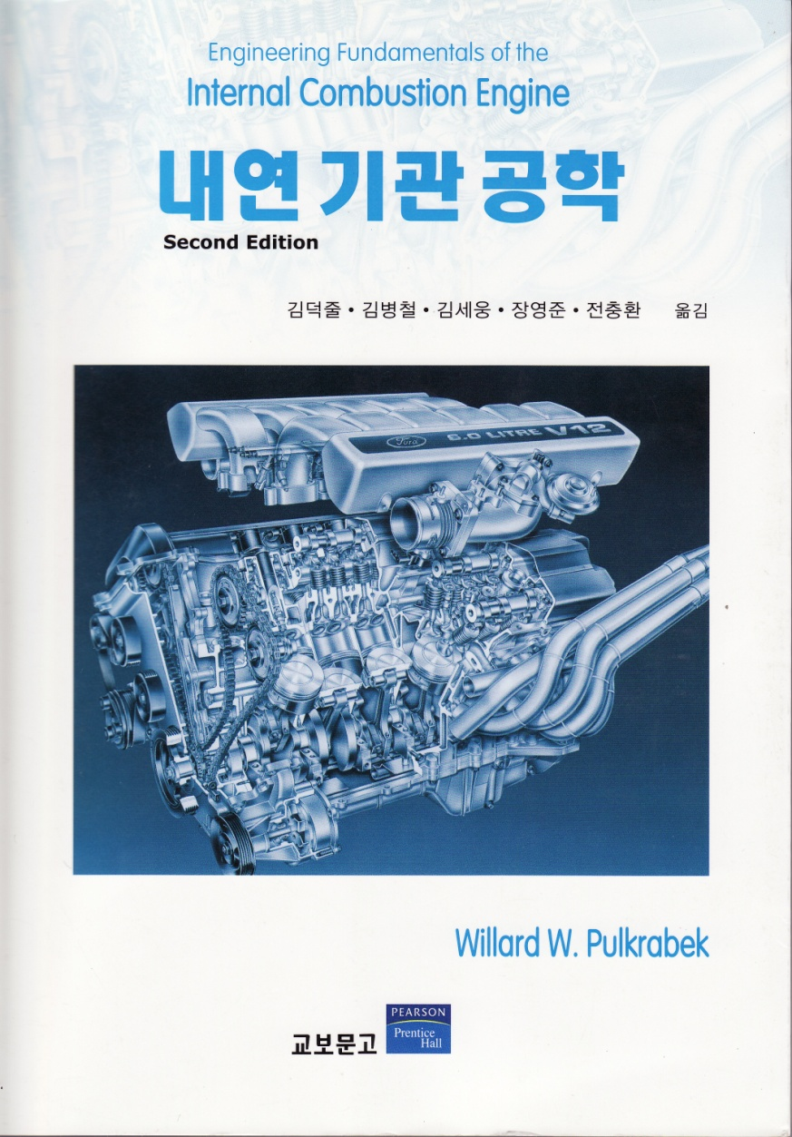
Reference
내연기관공학(Second Edition)
김덕줄외 5인공역
교보문고

Slide 8
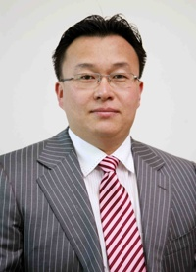
Research Laboratory: The Laboratory for Next Generation Fuel & Smart Powertrain
* Professor: Dr. Ock-Taeck Lim
* Experience
Professor, University of Ulsan, Ulsan, South Korea
National Traffic Safety and Environment Laboratory, Japan
* Education
Ph.D. in Mechanical Eng., 2006, Keio University, Minato, Japan
The Effects of Inhomogeneities on HCCI Engine Combustion
B.S. (1998), M.S. (2002) in Mechanical Eng., Chonnam University, Gwangju, South Korea
The Laboratory for Next Generation Fuel & Smart Powertrain
11 Doctor Course. students, 2 Master Course students
Topic 1: Next generation high efficiency low-emission combustion engine research
Topic 2: Visualization of spray atomization and spray combustion
Topic 3: Life-cycle analysis of next-generation automotive power during system(LCA)
Topic 4: Electric Vehicle
Funding sources: Government, Korea Gas Corporation(KOGAS), University of Ulsan
Point of contact: Prof. Ock Taeck Lim (otlim@ulsan.ac.kr)

